Slide 1
Concept Engineering Mixed-Technology Systems (CEMS)
Project Team WiSe 2024/2025
Mustafa Alkaya, Erdem Agfirat, Atakan Baydogan, Agah Osman Celebi

Slide 2
General Informations
System Overview
Signal Description
Inface Description
A/D Converter
Switched Capacitors and OTAs
LTspice analysis
xschem/ngspice
Implementation – Hardware – Software
Futue Outlook
Cost Calculation
References

Slide 3
System Overview
Analog
Digital I2C
Physical data input
ADC
MCU
ACC
Sensor for capturing acceleration data
ADXL 335
Converts analog signals from the ADXL into digital values
ADS 1115
Processing of digital data for filtering, or other computations
ESP 8266 μC

Slide 4
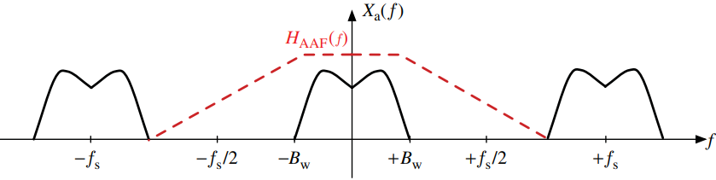
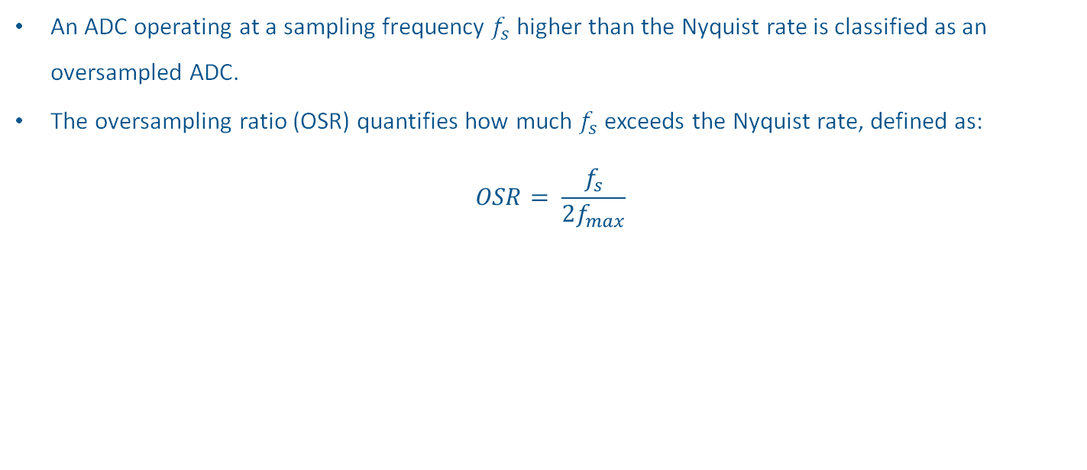
Oversampling
An ADC operating at a sampling frequency $f_{s}$ higher than the Nyquist rate is classified as an oversampled ADC.
The oversampling ratio (OSR) quantifies how much $f_{s}$ exceeds the Nyquist rate, defined as:
$$OSR= \frac{f_{s}}{2f_{max}}$$
Antialiasing filter for oversampling ADCs

Slide 5
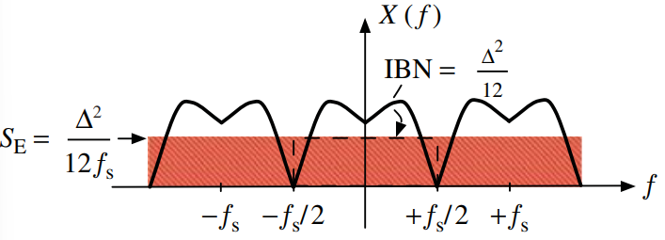
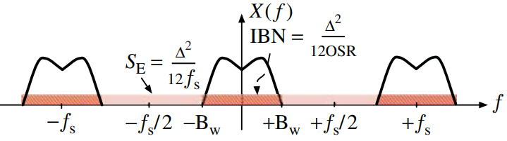
Oversampling
Quantization noise behaves in the frequency domain like white noise, with a constant power spectral density.
In a Nyquist ADC, all the quantization noise power remains within the signal band.
If an oversampled signal is quantized, only a fraction of the total quantization noise power lies withing the signal band.
Using an OSR of 4 is equivalent to having one extra bit in the N-bit quantizer.
Nyquist ADC
Oversampled ADC

Slide 6
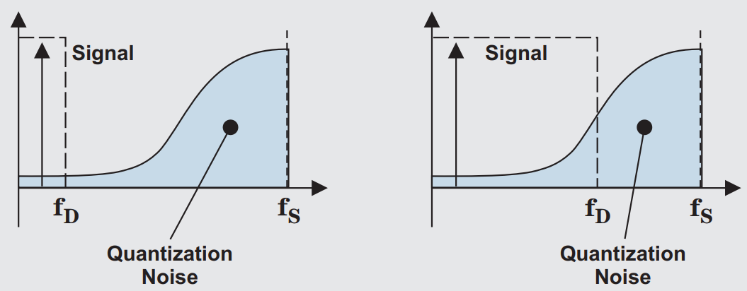
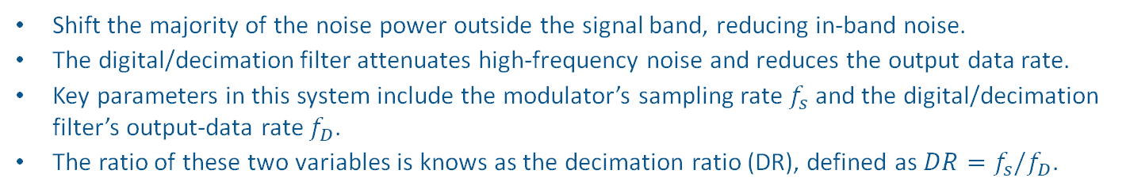
Noise Shaping and Digital/Decimation Filter
Shift the majority of the noise power outside the signal band, reducing in-band noise.
The digital/decimation filter attenuates high-frequency noise and reduces the output data rate.
Key parameters in this system include the modulator’s sampling rate $f_{s}$ and the digital/decimation filter’s output-data rate $f_{D}$.
The ratio of these two variables is knows as the decimation ratio (DR), defined as $DR=f_{s}/f_{D}$.
High DR decreases noise and low DR increase noise

Slide 7
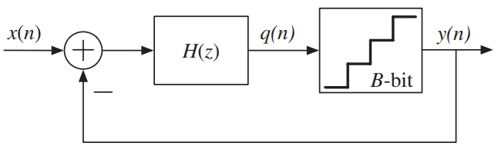
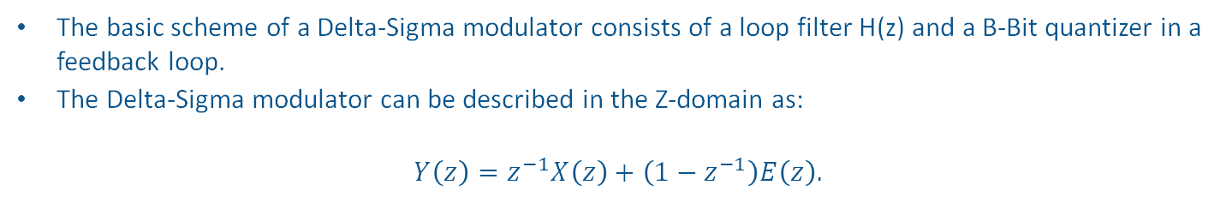
Block Diagram of the Delta-Sigma Modulator
The basic scheme of a Delta-Sigma modulator consists of a loop filter H(z) and a B-Bit quantizer in a feedback loop.
The Delta-Sigma modulator can be described in the Z-domain as:
$$Y\left(z\right)=z^{−1}X\left(z\right)+\left(1−z^{−1}\right)E\left(z\right).$$
Delta-Sigma Modulator

Slide 8
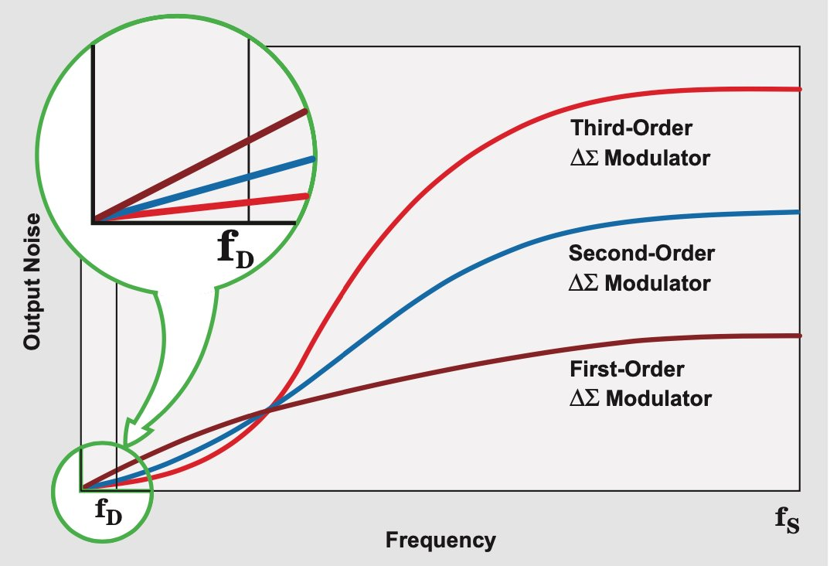
Higher Order Delta-Sigma Modulator
Using a circuit that integrates twice instead of just once is a great way to lower the modulator’s in-band quantization noise.
Some of the disadvantages of the second- or multi order modulators include increased complexity, multiple loops, and increased design difficulty.
Multi-order modulators shape the quantization noise to even higher frequencies than lower-order modulators.
Comparison of noise shaping

Slide 9
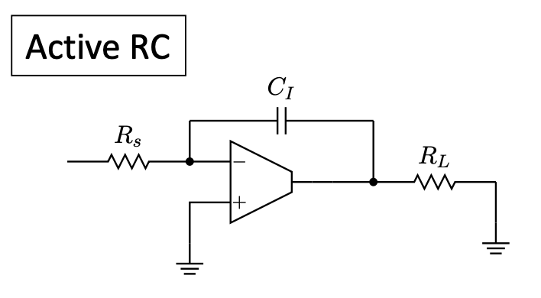
Active RC
Straightforward design using classical R–C relationships.
Typical implementation of low-pass, high-pass, Integrator, or other topologies
Large resistors require significant chip area.
Often chosen for simpler off-chip or hybrid solutions

Slide 10
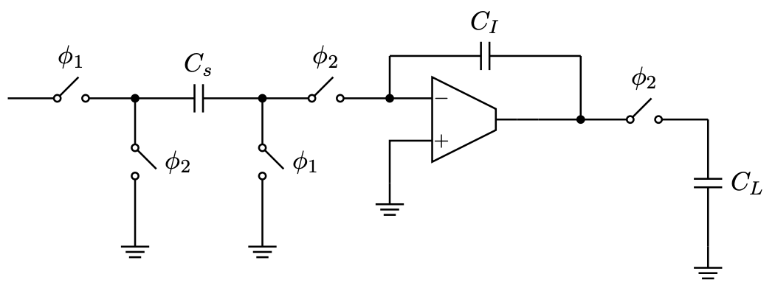
Switch Capacitor
Replaces large resistors with switches and small capacitors
A clock-driven capacitor emulates a resistor
only requires capacitors and switches (no bulky resistors)

Slide 11
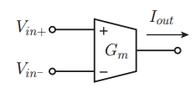
5 Transistor OTA (Operational Transconductance Amplifier)
Uses only five transistors
two for the differential pair
two for the current mirror load
one as the tail current source
Converts the differential input voltage (Vin+ − Vin−) into an output current (Iout), which can be fed into a next-stage load or an integration capacitor.
Notes:
M_{1,2} form a differential pair (biased by M₅)
M_{5,6} form a current mirrow (I_{bias} sets the bias in the OTA)
M_{1,2} is loaded by the current mirrow M_{3,4} which mirrows the drain current of M₁ to the right side
Current from M₄ and M₂ are summed for the Output

Slide 12
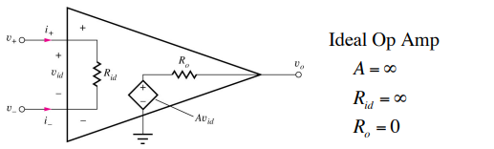
Op-amp vs. OTA (ideal case)
Op‐Amp (OPA) Ideal Characteristics
• Infinite input impedance
• Zero output resistance (voltage output)
• Infinite voltage gain
OTA Ideal Characteristics
• Infinite input impedance
• Infinite output resistance (current output)
• Infinite transconductance
Choosing an OTA vs. an Op‐Amp often depends on the load (high or low impedance)
OTAs can be simpler but less ideal for direct low‐impedance voltage outputs
Notes:
1. Op‐Amp (OPA) Ideal Characteristics
• Infinite input impedance: This means that, ideally, no current flows into the input pins, which prevents loading of the source circuit.
• Zero output resistance: In an ideal op‐amp, the output can drive any load with no voltage drop across the amplifier’s output terminal.
• Infinite voltage gain: The op‐amp can amplify a tiny difference between its inputs to produce a large (infinite, ideally) voltage output.
2. OTA (Operational Transconductance Amplifier) Ideal Characteristics
• Infinite input impedance: Like an op‐amp, an OTA does not draw current at its input.
• Infinite output resistance: An OTA’s output behaves like a current source rather than a low‐impedance voltage source, meaning it naturally drives high‐impedance loads.
• Infinite transconductance: The current out of the OTA is (ideally) linearly proportional to the input voltage difference, with an extremely high transconductance factor.
3. Key Insight
• Load dependence:
• If we place a high‐impedance (often capacitive) load on an OTA, it behaves similarly to an op‐amp with high gain.
• If we try to drive a low‐impedance load with an OTA, the voltage gain will be low, so we consider it a transconductance amplifier (producing a current output rather than a strong voltage output).
• Why choose OTA vs. Op‐Amp?: OTAs can often be simpler and require fewer components than op‐amps. In many integrated circuit designs, simpler is better if it meets the requirements for the application.

Slide 13
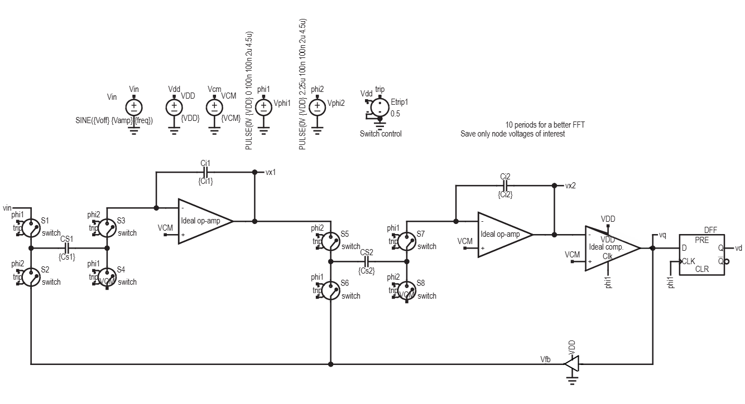
Circuit Simulation by LTspice

Slide 14
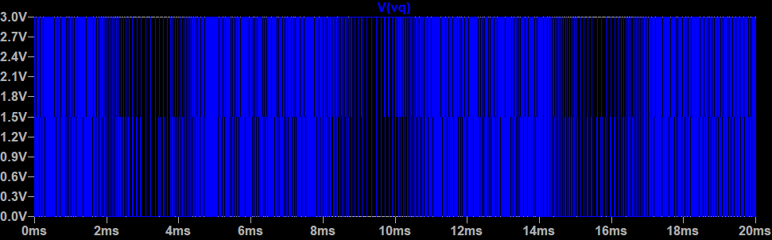
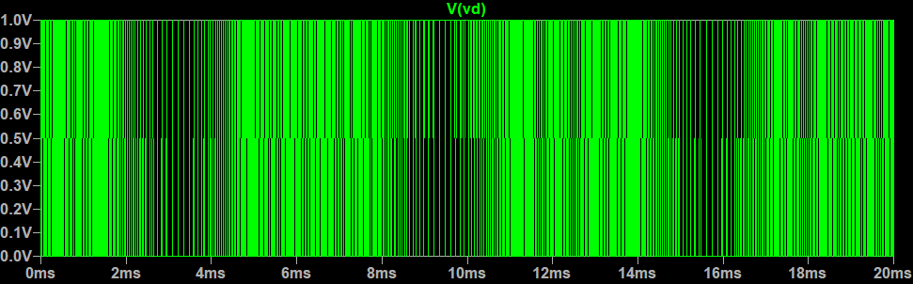
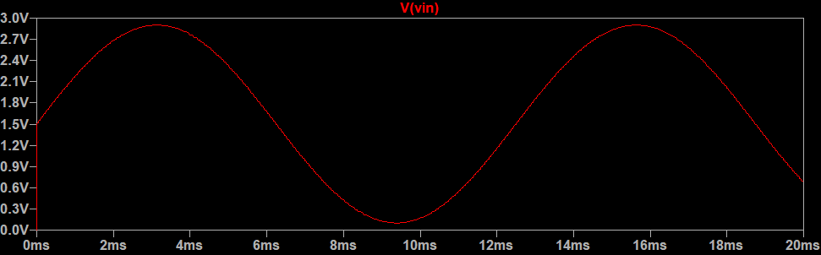
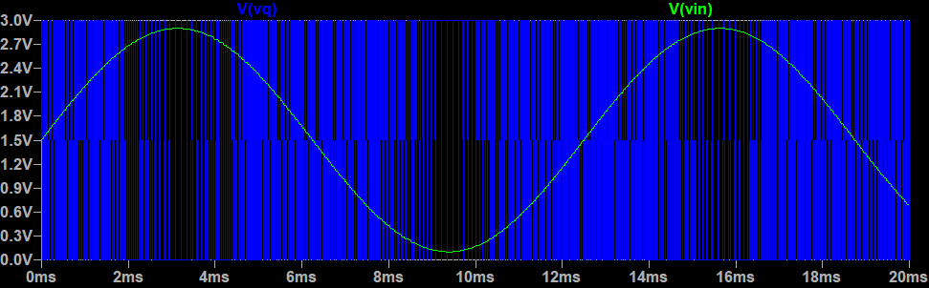
Circuit Simulation by LTspice

Slide 15
ASIC Design with IIC-Tools / xschem
Open Source Tools from JKU allow for new opportunuties in IC design
Docker Container allows software to run on many operating systems
Xschem is schematic capture tool like ltspice and the generated netlists can be simulated with ngspice
A handful of selected components can be simulated and later be routed to have a full custom design
Example components are:

Slide 16
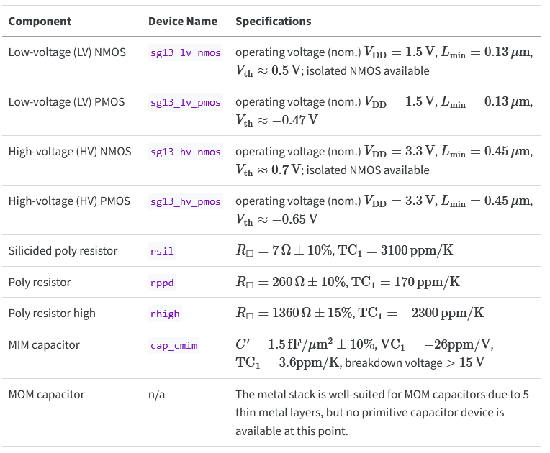
IC Level - Components
Selection of Components avaible from IHP SG13G3 PDK
Different components for different use cases
[H.Pretl-ACD]

Slide 17
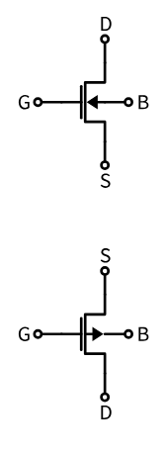
IC Level – Components - MOSFET
Commonly known P and N MOSFETs used for switching and amplification (in saturation or triode state, saturation => ID is controlled largely by Vgs)
Parasitics like gate-capacitance Cgs need to be taken into account
One of the most important MOSFET parameter: gm = Transconductance
Describes th behaviour of the Drain Current ID in relation to the Gate-Source Voltage
Id = gm*vgs
Parasitics and FET geometry influence transit frequency (current gain drops to unity): coarsly the maximum frequency of the FET (MOSFET should be used up to ft/10)
FETs are being dimensioned by gm/ID methodology, gm being the transconductance and ID is the drain current
Rule of Thumb states: gm/ID ≥ 10 for low voltage applications (takes less space too)
Gm/ID ≤ 5 for high speed circuits like in RF applications
SG13G2 LV NMOS usable up to 7.5 GHz approximately
[H.Pretl-ACD]

Slide 18
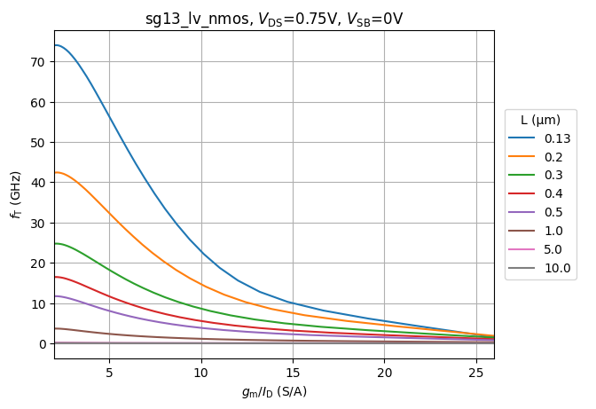
IC Level – Components - MOSFET
Plot shows relation of the transit frequency over gm/ID with different Channel Lengths
Our Circuits have FETs with a Channel Length of 130nm and a Channel Width of 1µm due to smaller overall chip are and drain current and gate-source voltage threshold
Basically, to change gm/ID the W/L ratio needs to be changed, ideally leaving the channel length constant and increasing or decreasing the channel width W
[H.Pretl-ACD]

Slide 19
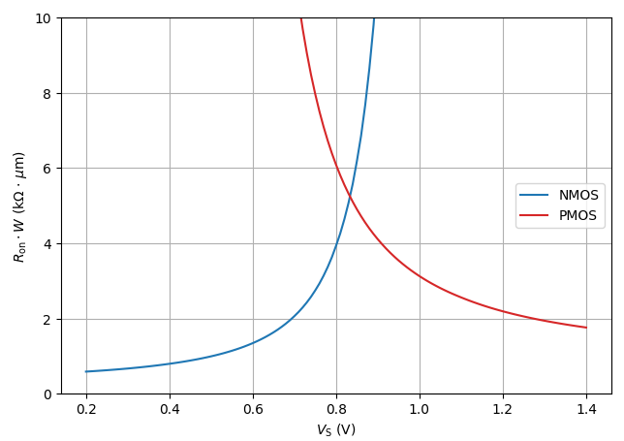
IC Level – Components - MOSFET
Plot shows relation of FET resistance and source voltage, plot to show that every parameter influences FET behaviour
Low resistance for low voltage at NMOS and low resistance for high voltage at PMOS show where they can ideally be used
At lowside and highside respectively
[H.Pretl-ACD]

Slide 20
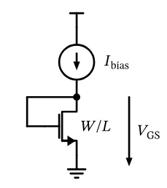
IC Level – Subcircuits – MOSFET as Diode
Bias Current controls drain current (Kirchhoff says hi) by projecting the drain-source voltage drop to the gate
W, L and bias current act together to create a specific voltage drop which can later be used for additional current sinks (FETs with exacly the same gate-source voltage as this one)
Calculation as follows:
Desired bias current: 20 µA, gm/ID = 10, L = 130 µm
Find our W from drain-current to width ratio over gm/ID curves for our channel length and bias current
We get approx. 1 µm channel width
[H.Pretl-ACD]

Slide 21
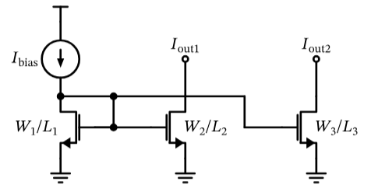
IC Level – Subcircuits – Current Mirror
As mentioned current mirror is one additional or more FET Gates connected to the FET as Diode Circuit
Currents in the stages two and three can be trimmed by the ratio of W/L by the following approximation
Ioutx = Ibias * Wx/Lx * L1/W1
Current Mirror later being used for biasing and loading differntial pairs
[H.Pretl-ACD]

Slide 22
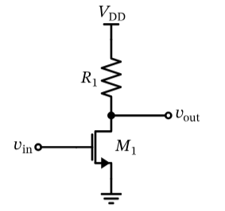
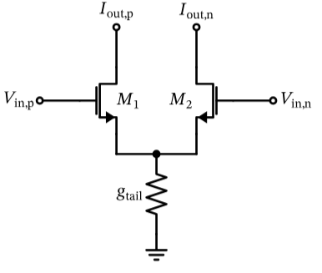
IC Level – Subcircuits – Common Source Amplifier and Differential Pair
The common source amplifier amplifies signals and inverts them
Amplification depends on transconductance gm and collector resistance R
The DC Amplification ratio is:
Av = vout/vin = -gm*vin*R / vin = -gm*R
Two common source amps together make a differential pair
The differential pair has a inverting and a non-inverting input and amplifies differential signals
Differential meaning the difference of voltages between vin,p and vin,n
The differential input voltage is vin = Vin,p – Vin,n
Common mode voltages cancel out each other
With the same transconductance (for gm,M1 and gm,M2) we get I,out = iout,p – iout,n = gm*vin
[H.Pretl-ACD]

Slide 23
IC Level – xschem and ngspice
Following pictures show the design of a first order IDSM with our own OTA as the central building block
OTA was here used as an Integrator and Comparator
D-Flip Flop was implemented with NAND and NOR Gates
A double Pull-Push Stage was used at the output of the 1-Bit Feedback to drive this signal (basically a buffer)

Slide 24
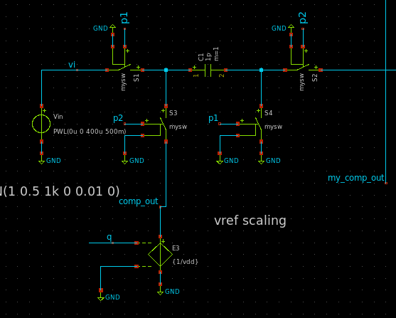
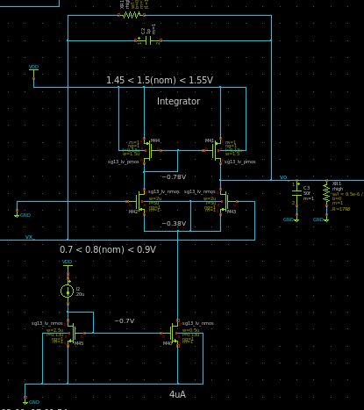
IC Level – xschem and ngspice
[own work, xschem]
[own work, xschem]

Slide 25
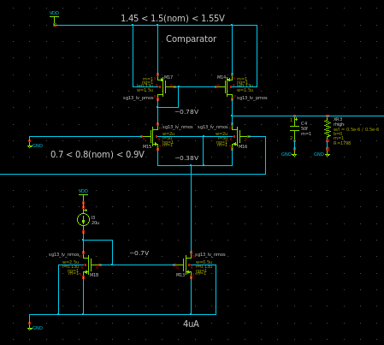
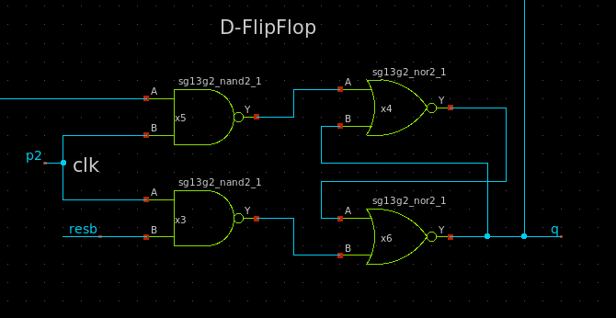
IC Level – xschem and ngspice
[own work, xschem]
[own work, xschem]

Slide 26
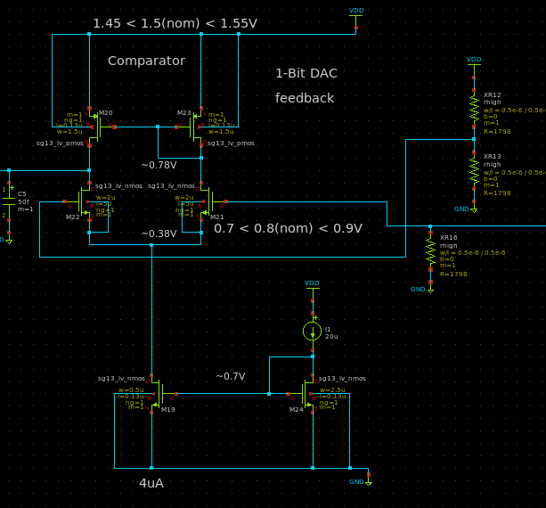
IC Level – xschem and ngspice
[own work, xschem]

Slide 27
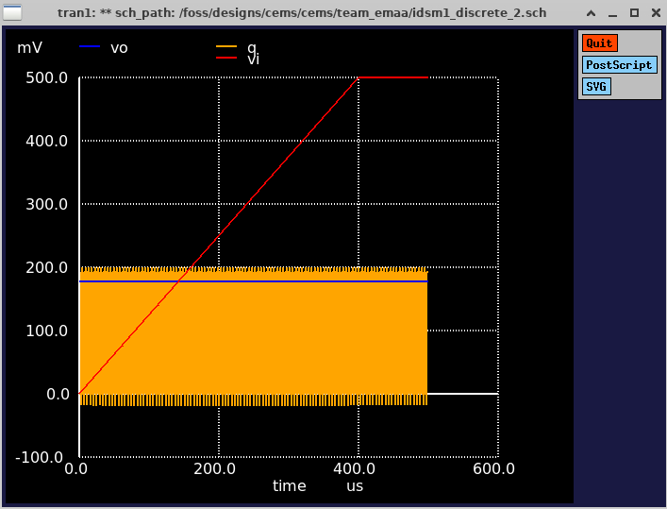
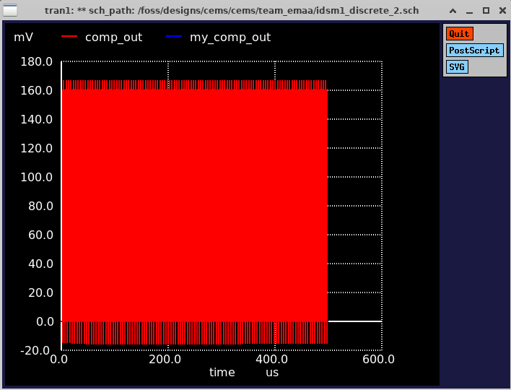
IC Level – xschem and ngspice
[own work, xschem]

Slide 28
Semiconductor/ASIC Outloook
The next steps in the design of the ADC would include the implementation of the digital filter as well as the decimator
Additional circuitry like a I2C interface, MUX, PGA, IO-protection and Level Shifting as well as input Filters and more could be designed and implemented step by step
The simulations then need to be verified and optimized if necessary
After simulation we would do the layout, i.e. the physical placement and routing in klayout
After this we would let this IC be manufactured, wire bonding applied, packaged inside the X2QFN Package and soldered onto our Testboard
On the Testboard the simulated IC can now be evaluated and verified with measurements

Slide 29
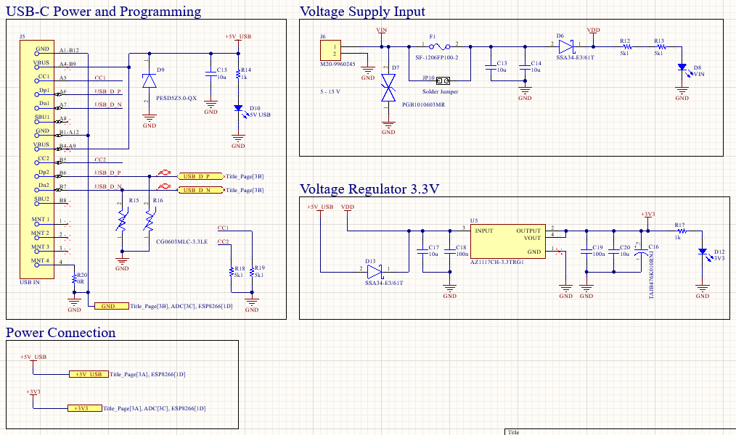
Implementation Hardware - Schematic
[own work, Altium Designer]

Slide 30
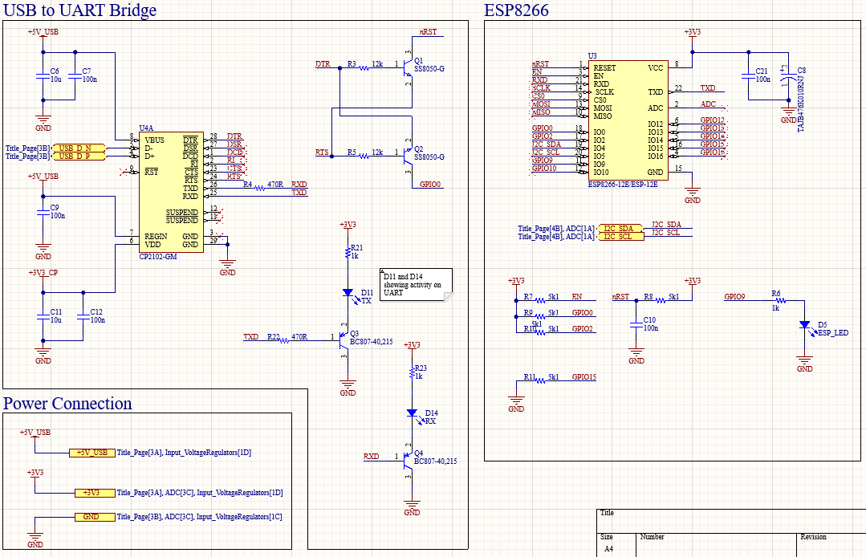
Implementation Hardware - Schematic
[own work, Altium Designer]

Slide 31
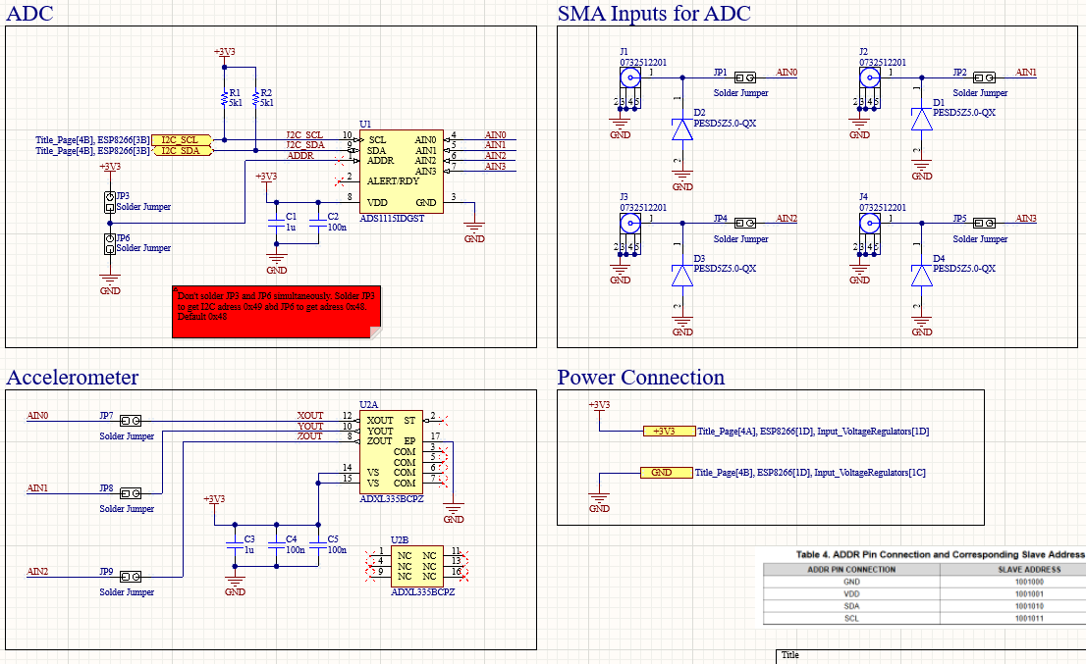
Implementation Hardware - Schematic
[own work, Altium Designer]

Slide 32
Implementation Hardware - PCB
Features:
Low Cost 4 Layer PCB with two inner ground planes
Power Routed instead of dedicated power plane
Short via-shielded Analog Traces
Sufficient spacing between analog/signals (e.g. 3H rule)
USB-C (EU requirement)
Locally manufactured (Aisler, Multi-CB, LeitOn)
ESP8266 for simple programming, fast prototyping and WiFi Connectivity
Return/reference Vias for Reference-plane changing signals
Debug LEDs and LEDs on UART-Signal lines
Fully ESD Protected
Edge-Via Stitching for better EMI immunity
Simulation of PDN Voltage drop – because of ADC Voltage VREF

Slide 33
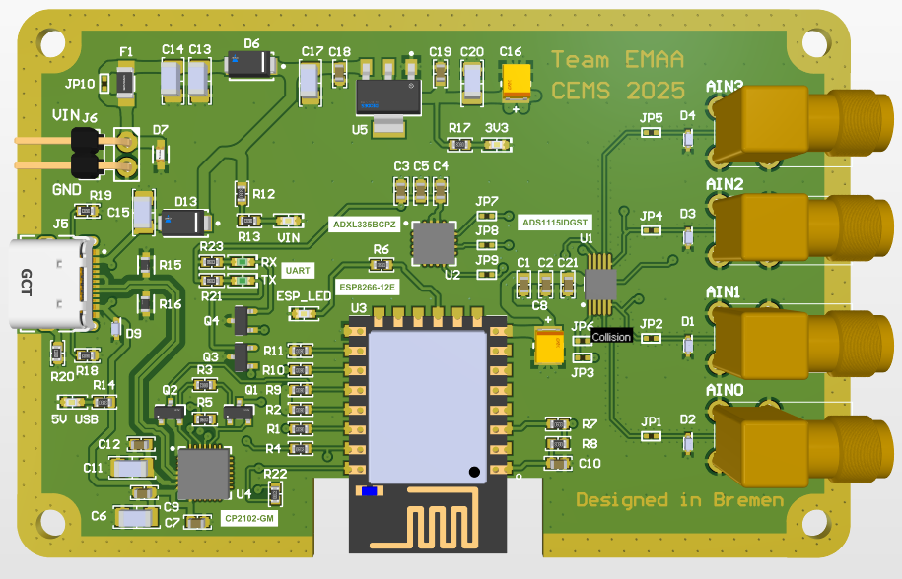
Implementation Hardware - PCB
[own work, Altium Designer]

Slide 34
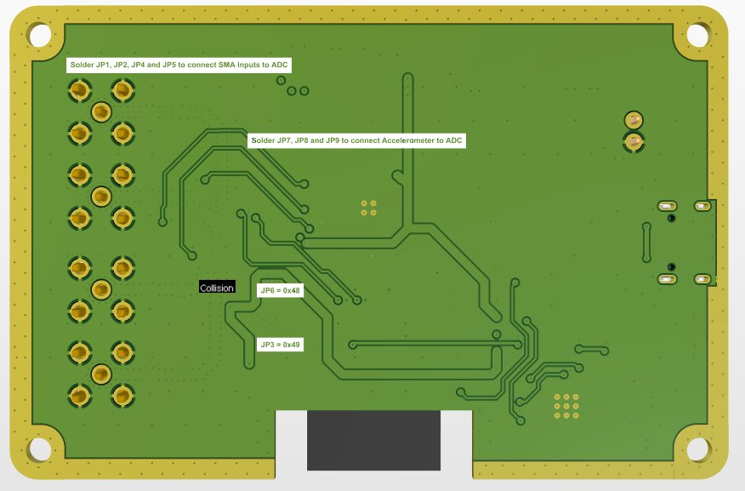
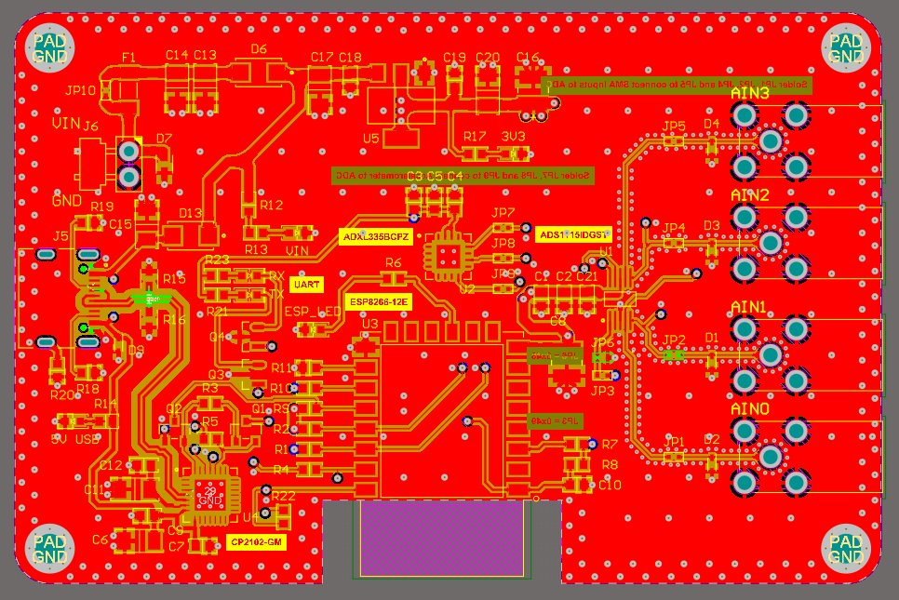
Implementation Hardware - PCB
[own work, Altium Designer]

Slide 35
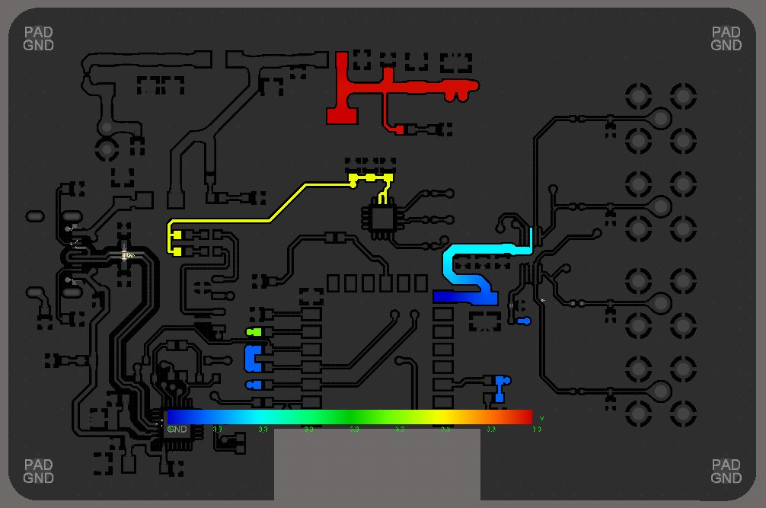
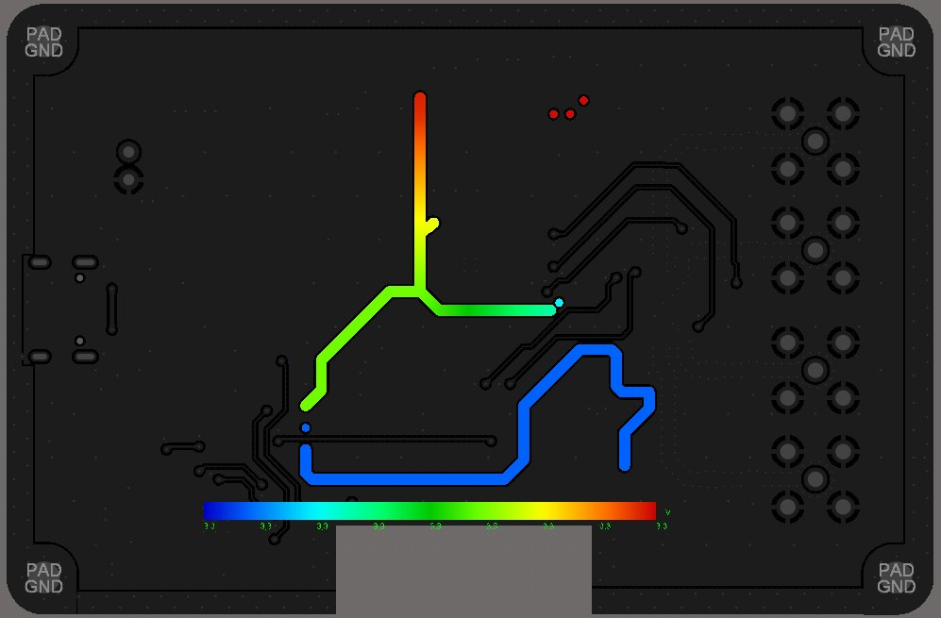
Implementation Hardware – PCB – Voltage Drop
Voltage drop could be important for Vref
Red = 3.3V
Blue = 3.295V
Simulated slightly higher current draw!
[own work, Altium Designer]
Simulated with PowerAnalyzer by Keysight

Slide 36
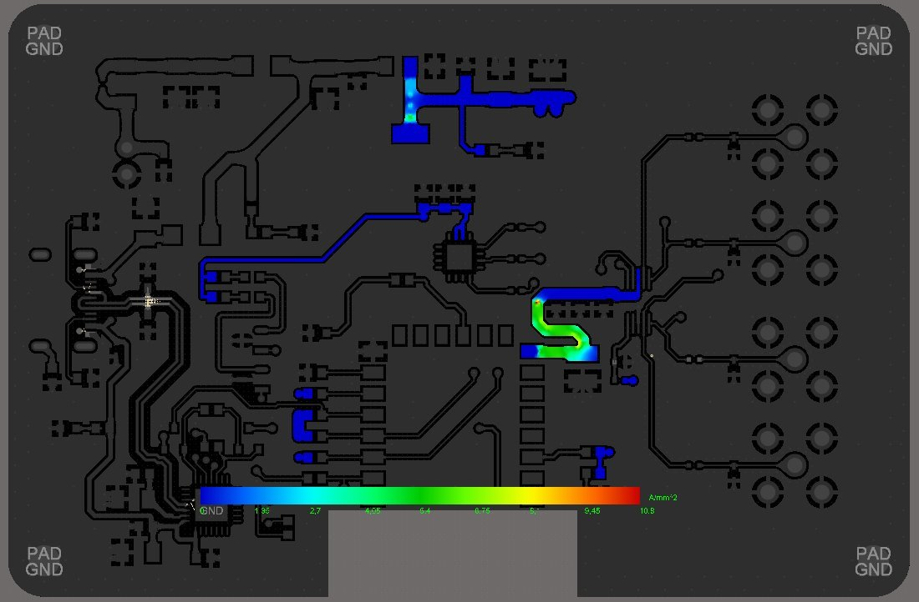
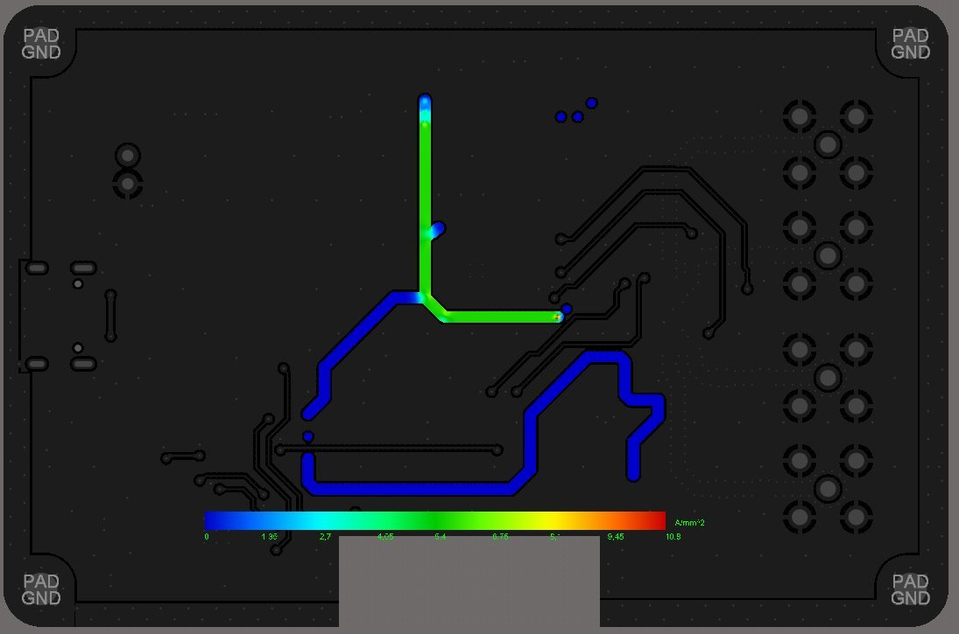
Implementation Hardware – PCB – Current Density
Current Density: max. ~5A/mm^2
[own work, Altium Designer]

Slide 37
Implementation Testbed
Soldering IC on our Testbed and taking following measurements with our Delta-Sigma ADC:
Working? [Y/N]
Sampling Rate [SPS]
Power Consumption [mW/µW]
Input Impedance [MΩ]
Output Datarate [SPS/ bit/s]
Resolution [bits]
LSB size [µV]
Many more parameters which could be measured but are more difficult to obtain
Also creating graphs and testing under different environmental and electrical cases (-40 °C to 125°C etc.)

Slide 38
Implementation Arduino
Arduino Readout of ADS1115
Input of known defined sine signal to achieve reproducible measurements with custom ADC
Code running on ESP8266 – ideally on self designed Testbed
Later Extraction of single measured samples from ADS1115 and Team EMAA ADC for further analysis with MATLAB and other tools

Slide 39
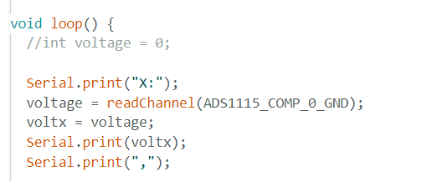
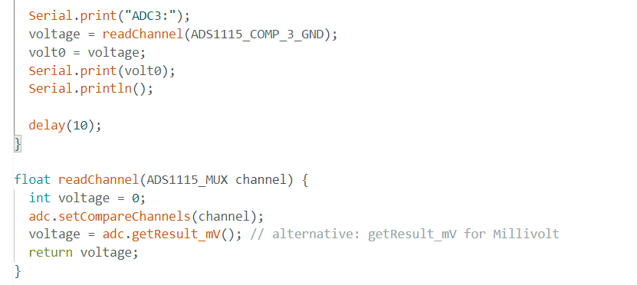
Implementation Arduino
[own work/ARDU]

Slide 40
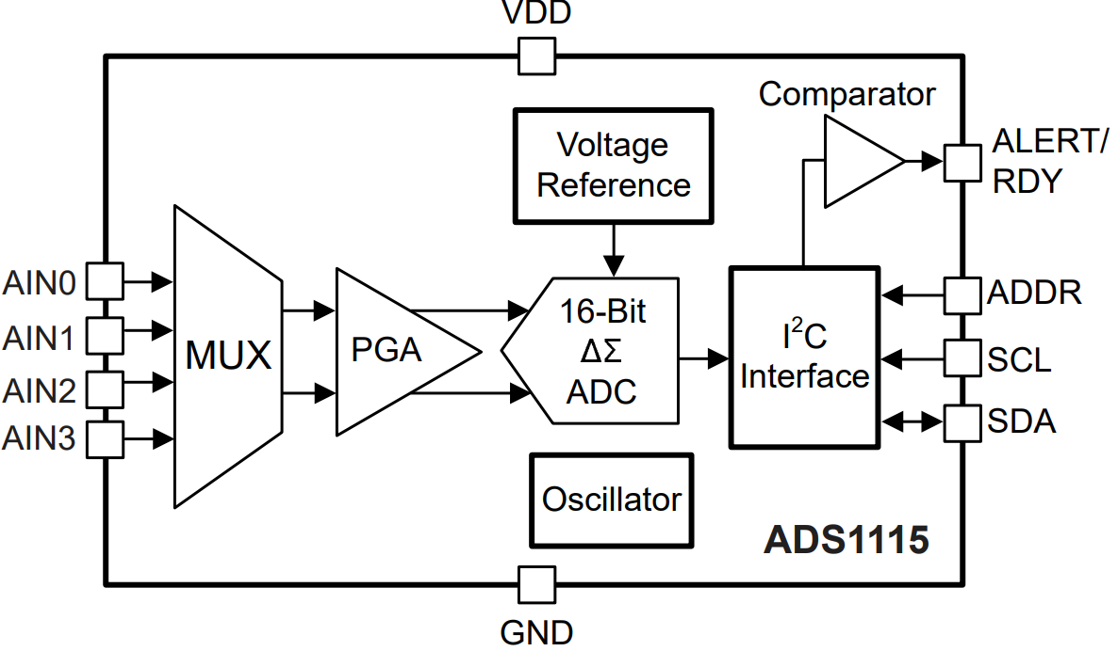
ADS1115
Specifications
Dynamic Range (DR): 16 bits
Signal Bandwidth (B/bw): 215 Hz
Nyquist Frequency (f_{N}): 430 Hz
Modulator Order: 2
Sampling Frequency (f_{S}): 220 kHz
Oversampling Ratio OSR (M=f_{S}/f_{N}): 512 Hz

Slide 41
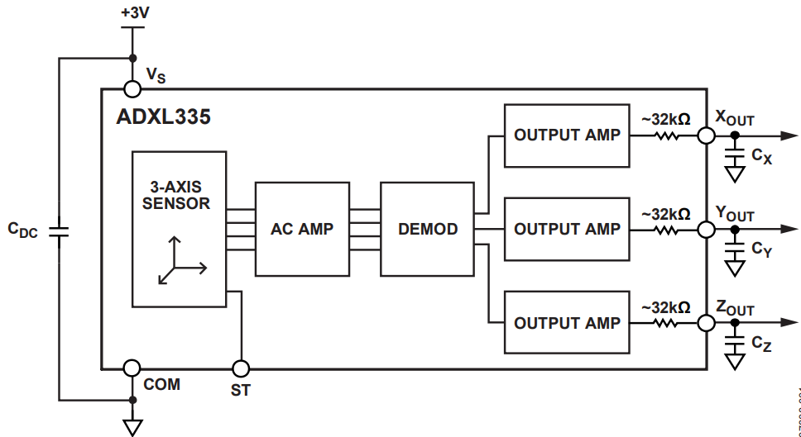
ADXL335
Specifications
3-axis (X, Y, Z) analog output accelerometer
Operating voltage: 1.8V – 3.6V (Typically 3.3V)
Analog voltage output
Measures acceleration through capacitive sensing
X, Y, Z axis outputs can be read using ADC
Uses MEMS (Microelectromechanical Systems) technology

Slide 42
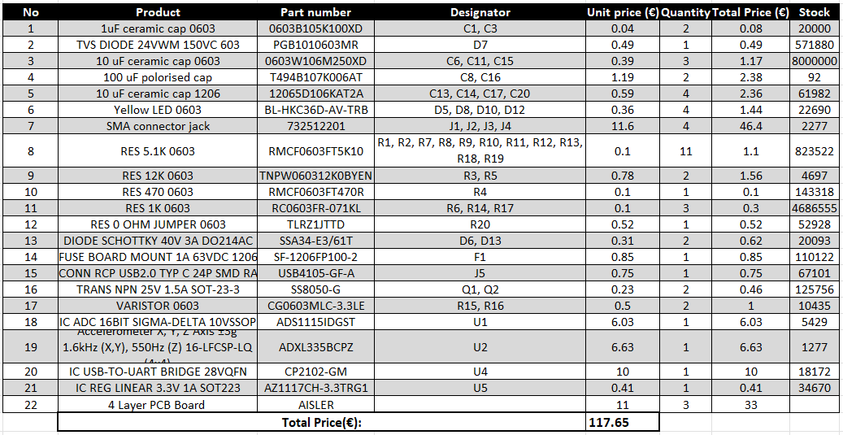
Cost calculation
Table: Bill of materials (Source: digikey)

Slide 43
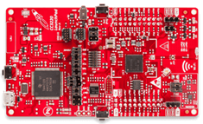
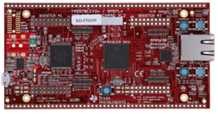

Our Catalog
MCU’s | CC3200 LaunchPad | Hercules TMS570LC43x | NodeMCU ESP8266
Microcontroller / SoC | ARM Cortex-M4, 32-bit | ARM Cortex-R5F, 32-bit | ARM Cortex-M4, 32-bit
Target Market / Focus | IoT, wireless applications | Functional safety, automotive | IoT, hobby/home electronics
On-board Wi-Fi | Yes | No | Yes
Operating Frequency | 80 MHz | Up to 300 MHz | 80/160 MHz
Supply Voltage | 5V via USB, on-board 3.3V regulator | 5V via USB, on-board 3.3V regulator | 5V via USB, on-board 3.3V regulator
Temperature Range | -20°C to +85°C | -40°C to +125°C | 0°C to +40/70°C
Price | $ 55 | $ 60 | € 10.14
Price with ADXL335 and ADS1115 Breakout Board | € 105 | € 120 | € 70.14

Slide 44
References
[Meiners]: M.Meiners, Lecture Slides, https://aulis.hs-bremen.de/ilias.php?baseClass=ilrepositorygui&cmd=view&ref_id=939269, 04.02.2025
[CMOS Sigma-Delta Converters], CMOS SD Converters: Practical Design Guide, de la Rosa, del Rio, https://onlinelibrary.wiley.com/doi/book/10.1002/9781118569238, 04.02.2025
[HOROWITZ]: Horowitz, P., & Hill, W. (2015), The Art of Electronics, Cambridge University Press, 06.02.2025
[BONNIE]: B.Baker, How delta-sigma ADCs work, Part1/2, Texas Instruments, https://www.ti.com/lit/an/slyt423a/slyt423a.pdf?ts=1739265696913&ref_url=https%253A%252F%252Fwww.google.com%252F, 24.01.2025
[H.PRETL]: H.Pretl, Michael Koefinger, (02.02.2025), Analog Circuit Design, Johannes Kepler University, https://iic-jku.github.io/analog-circuit-design/, 11.02.2025
[ARDU]: Wolfgang Ewald, (06.01.2021), ADS1115 – A/D converter with amplifier, https://wolles-elektronikkiste.de/en/ads1115-a-d-converter-with-amplifier, 04.02.2025,

Slide 45
THANK YOU FOR YOUR ATTENTION!

Slide 46


Spectral Analysis MATLAB/SIMULINK

Slide 47










Rückkopplung als Regelkreis
Desensitization to active parameters
$\frac{V_{o}}{V_{i}}=\frac{A}{1+Aβ} <A, if A⋅β positive$
Wenn $A⋅β≫1⇒ \frac{V_{o}}{V_{i}}=\frac{1}{β}$
Improving the linearity
$V_{o_{ol}}=V_{offset}+A⋅V_{i}+K_{2}V_{i}^{2}+K_{3}V_{i}^{3}…$
$V_{o_{cl}}=\frac{V_{offset}}{1+Aβ}+\frac{A}{1+Aβ}⋅V_{i}+\frac{K_{2}ε^{2}+K_{3}ε^{3}…}{1+Aβ}$
Improving the bandwidht
${V_{o}}_{cl}=\frac{A}{1+Aβ}⋅\frac{ωc⋅\left(1+Aβ\right)}{s+ωc⋅\left(1+Aβ\right)}⋅V_{i}$
Open-loop
$$V_{i}$$
A$(s)$
$$V_{o}$$
Closed-loop
+
$$V_{i}−V_{o}β=ε$$
$$A(s)$$
$$V_{i}$$
-
$$V_{o}$$
$$β⋅V_{o}$$
$$β$$

Slide 48



Velocity and Acceleration – Data Source / Analog
Detect the rate of change in velocity and can track the position and orientation of moving objects
Based on Newton‘s second law $F=ma,$where a known mass ($m)$experiences a force ($F$), causing a acceleration ($a)$
Key Components: proof mass, spring, damper an d displacement sensor
Types of sensors: Capacitive Sensors, Piezoelectric sensors, thermal sensors

Slide 49


Stabilitätsanalyse
Phasenwinkel $φ_{K}$ zu der Frequenz $f_{K}$
Phasenreserve $α=180°− \left|φ_{K}\right|$
Für $\left|φ_{K}\right|>180° ist die Phasenreserve negativ$
Schaltung ist Instabil und beginnt selbsterregt zu schwingen
Gutes Einschwingverhalten erfordert einen Wert für $α$ zwischen 60°$−$80°
Verwendung des Bode-Diagramms zur Stabilitätsanalyse [6]

Slide 50

Stabilitätsanalyse – Frequenzgangkorrektur
Universelle Frequenzgangkorrektur [6]

Slide 51


MOSFET – Grundlagen
Circuit Symbol MOSFET [2]
N-channel MOSFET [1]
In an NMOS, current flows from drain to source when a positive voltage is applied to the gate
In a PMOS, current flows from source to drain when a negative voltage is applied to the gate

Slide 52



MOSFET – Kleinsignalmodell
Representation of a MOSFET at low voltages in the linearized region
Open circuit between gate and source –> $I_{G}$ = 0
Current source represents the drain current $I_{D}$
$g_{m}$ the transconductance is determined by drawing a tangent to the$I_{D}$ vs. $V_{GS}$ relationship

Slide 53
MOSFET – Structure_ATAkan
In an NMOS, current flows from drain to source when a positive voltage is applied to the gate
In a PMOS, current flows from source to drain when a negative voltage is applied to the gate

Slide 54


Stabilitätsanalyse – Ersatzschaltbild einer dreistufigen Verstärkerschaltung
Einzelne Verstärkerstufe:
$$H\left(jω\right)=\frac{U_{a}}{U_{e}}=\frac{V}{1+jωRC}$$
Bei der Reihenschaltung von mehreren Verstärkerstufen ergibt sich:
$$\frac{\left|V_{1}⋅V_{2}⋅V_{3}\right|}{\left(1+jωR_{1}C_{1}\right)⋅\left(1+jωR_{2}C_{2}\right)⋅\left(1+jωR_{3}C_{3}\right)}$$

Slide 55



Spectrum_erdem

Slide 56



Quantization_erdem

Slide 57


ADC

Slide 58

ADC_Erdem

Slide 59

Simulink Schaltung und Ergebnisse (simulink)Erdem

Slide 60


ADC_Erdem

Slide 61



Capacitor Formulas
https://www.electronics-tutorials.ws/opamp/opamp_6.html
https://electricalacademia.com/basic-electrical/inductor-capacitor-basics/

Slide 62
PCB Design - Altium
Design of a Schematic and PCB to function as a Eval-board and Testbed for the ADCs
Prefered over a Breadboard or perfboard because of lower stray inductances and better Signal/Power Integrity
Simple Schematic Design with focus on basic functionality
PCB Design with all in one solution – no additional adapters or uC required
After IC design – swap of ADS1115 with our ASIC possible
Goal:
Ideally direct comparison between our ADC and COTS Part ADS1115

Slide 63

IC Level – OTA
OTA is a combination of the differential pair with current mirrors
Current output can be "converted" to a voltage by adding a resistor as a load to the output
Known OpAmp circuits like the voltage follower, integrator, summing amplifier and comparator can be build with the OTA
OTA subcircuit components (the FETs) are being sized with the help of Jupyter Notebooks which contain all the necessary parameters and sizes
These tools provided by Prof. Pretl simplify the sizing of our xschem circuit
The following xschem schematic shows our DSM

Slide 64
References

